Slide 1



The basis of the theory of chemical bonds in various types of compounds. The main types of chemical bonds. Basic rules of the theory of valence bonds (VB).
Al-Farabi Kazakh National University
Faculty of Chemistry and Chemical technology
Department of General and Inorganic Chemistry
pHd Bakhadur askar

Slide 2
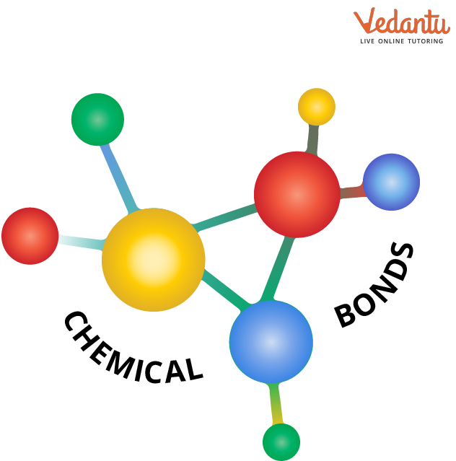
Chemical bonding
Chemical bonding is the force that holds atoms together to form molecules and compounds.
Understanding bonding is essential for explaining the structure, stability, and properties of substances.
Theories of bonding, including Valence Bond (VB) theory and Molecular Orbital (MO) theory, help describe how atoms combine and share electrons.
Chemical bonds arise mainly from the interactions between the outermost (valence) electrons of atoms.

Slide 3
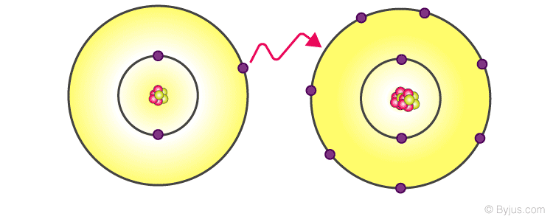
The basis of the theory of chemical bonds
Atoms tend to achieve stable electronic configurations similar to noble gases (octet rule).
Bonds form when atoms gain, lose, or share electrons to achieve stability.
The type and strength of a bond depend on electronegativity differences, orbital overlap, and energy minimization.
The formation of a chemical bond always leads to a decrease in the total potential energy of the system.

Slide 4
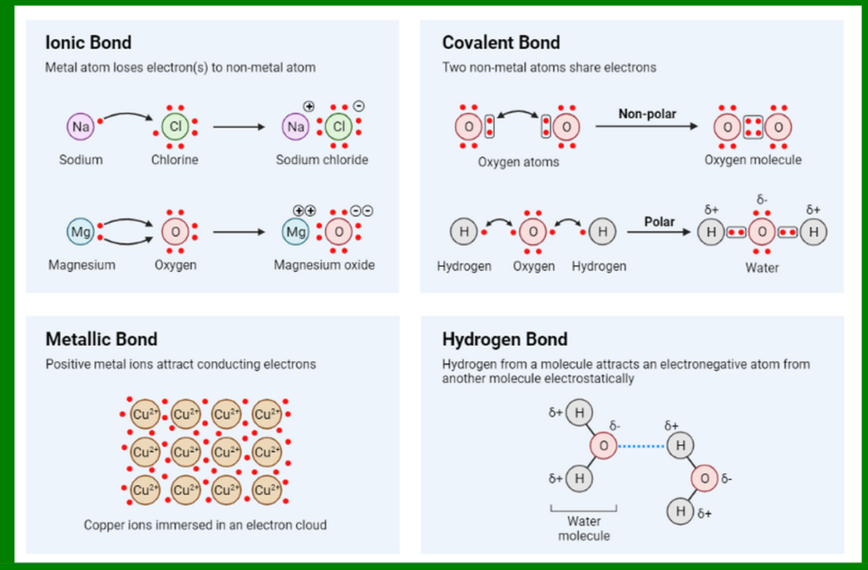
Main types of chemical bonds
Ionic Bond- formed by electron transfer between metals and nonmetals. Example: NaCl (Na⁺ and Cl⁻).
Covalent Bond- formed by sharing electron pairs between atoms. Example: H₂, O₂, CH₄.
Metallic Bond- electrons are delocalized and move freely among metal cations. Explains conductivity and malleability in metals.
Coordinate (Dative) Bond ( Hydrogen bond- case of this dono-acceptor bond)
Both shared electrons come from one atom (donor → acceptor). Example: NH₄⁺ ion formation.

Slide 5
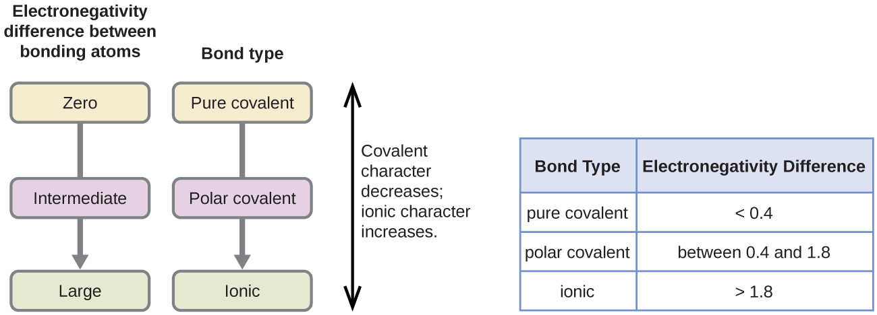
Polarity and bond characteristics
Polarity depends on the difference in electronegativity between bonded atoms.
Nonpolar: equal sharing (e.g., H₂, Cl₂).
Polar: unequal sharing (e.g., HCl, HF).
Bond length: average distance between nuclei of bonded atoms.
Bond energy: energy required to break one mole of bonds.
Bond order: number of shared electron pairs between atoms.

Slide 6
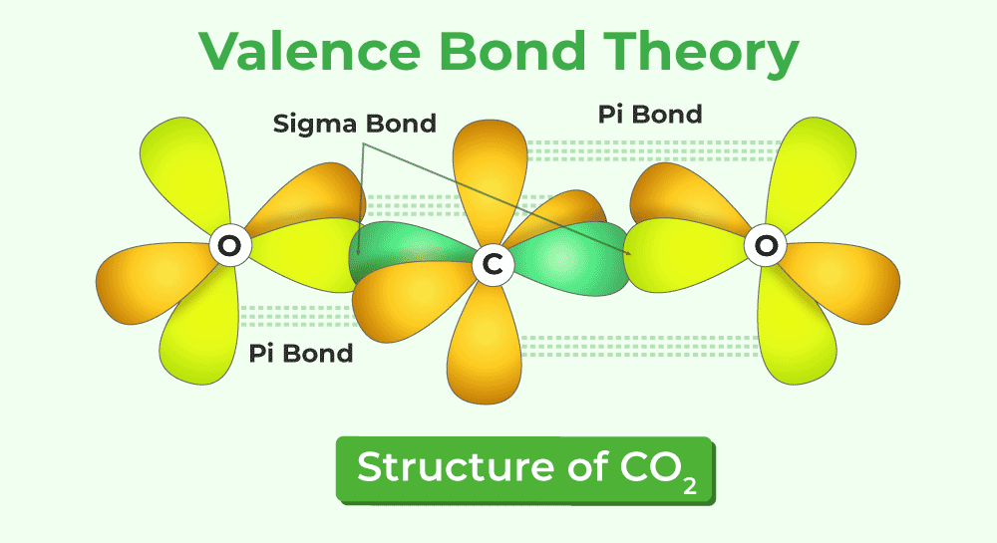
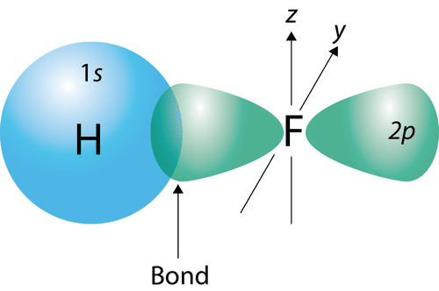
Introduction to valence bond (VB) theory
Proposed by Heitler and London (1927) and developed by Pauling and others.
VB theory describes covalent bonding in terms of overlapping atomic orbitals containing unpaired electrons.
A chemical bond forms when two atomic orbitals overlap and share a pair of electrons with opposite spins.
Emphasizes localized bonds between specific pairs of atoms.

Slide 7
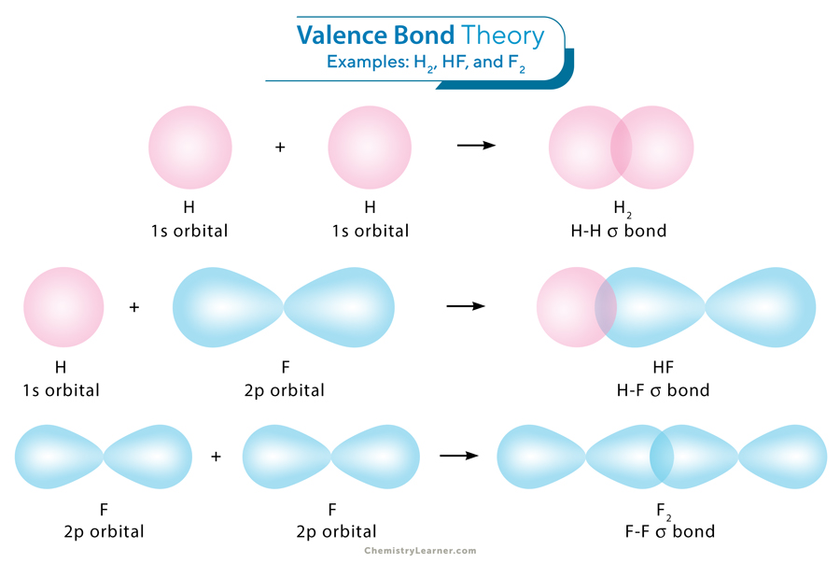
Basic rules of valence bond theory
Overlap principle : the greater the overlap between atomic orbitals, the stronger the bond.
Opposite spins : bonding electrons must have opposite spins.
Hybridization : atomic orbitals mix to form new equivalent orbitals (sp, sp², sp³, etc.).
Resonance : when multiple Lewis structures are possible, the actual molecule is a hybrid of all.
Energy consideration : bond forms only if total energy of the molecule is lower than that of separated atoms.

Slide 8
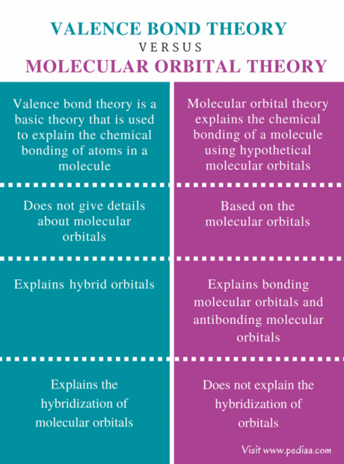

Slide 9
Conclusion
Chemical bonds are the foundation of all chemical structures and reactions.
The main types of bonds—ionic, covalent, metallic, and coordinate—arise from different electron interactions.
Valence bond theory provides a powerful localized approach to understanding covalent bonding through orbital overlap and hybridization.

Slide 10

Questions?

